Slide 1


托福听力8
金牌听力名师
大菁儿老师
2021.6.18

Slide 2
第七节课回顾： 十大考点——因果+转折； 文化艺术词汇串讲及菁讲精练

Slide 3
十大考点——过程+结论；
二级学科词汇精讲：植物学+环境科学

Slide 4
考点记过程——历史题、地质题、气象学
考试难点：有时候不给你提示，全文说完了，让你自己排序，那你按照你自己的笔记顺序排就行了
规律性的是如果老师说到这样一些词，可能会有排序：development, formation, process, procedure, method,
approach, evolution
听顺序first, second, third, then

Slide 5
过程题练习1
TPO4-L4 政府对艺术的支持
1'17-2'54
Kennedy
unemployment
federal subsidy 联邦津贴
financial assistance
cultural institution
endowment (NEA) 捐赠
council 委员会 理事会

Slide 6
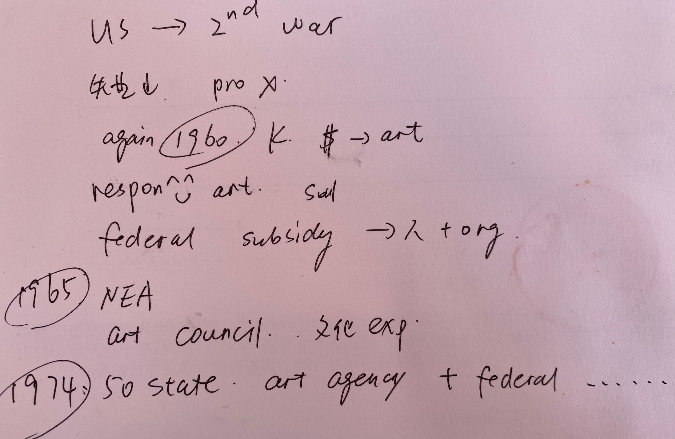
TPO4-L4 政府对艺术的支持
笔记

Slide 7
重要的时间点有 the first attempt, in 1965, mid 1970s 。按照信号词将选项排序
TPO4-4
3.The class discusses some important events related to government support for the arts in the United States. Put the events in order from earliest to latest.
[Drag each sentence to the space where it belongs. The first one is done for you.]
A.Arts councils were established in all 50 states of the country.
B.The federal budget supporting the arts was reduced by half.
C.The Federal Art Project helped reduce unemployment.
D.The National Endowment for the Arts was established.

Slide 8
过程题练习2
TPO50-L1古埃及的玻璃制造 1'58-3'02
quatz 石英
transparent
crush 压碎 碾碎
plant ash
vessel 容器
jar 罐子
clay
glassy
metallic dye
pour
disk-shaped mold 模具
ground 磨碎

Slide 9
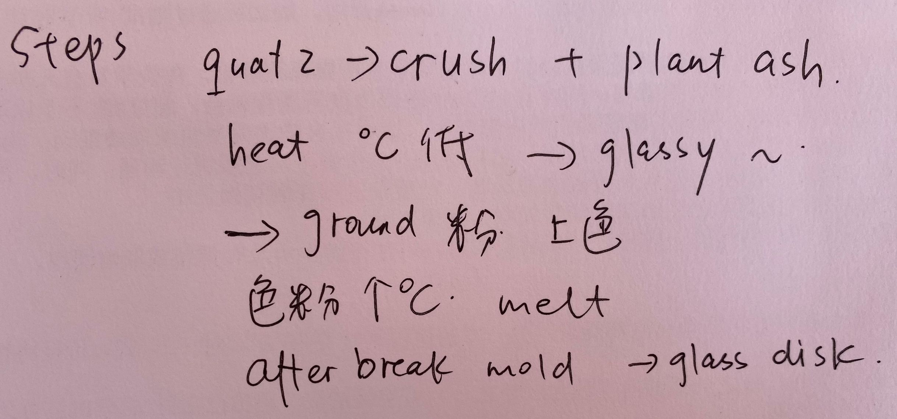
TPO50-L1 古埃及的玻璃制造
笔记

Slide 10
3.The professor describes a process for making glass disks. Summarize the process by putting the steps in the correct order.
[Click on a sentence. Then drag it to the space where it belongs. The last one is done for you.]
A.Glass-like material is ground up and dyed blue or red.
B.Powdered material is heated at very high temperatures.
C.Crushed quartz and plant ash are heated at low temperatures.
D.Containers are broken to remove glass disks.

Slide 11
考点十：记结论——看进度条！
出现在文章结尾的信息点
有时候会用信号词引出。有时候就直接总结了
在讲座快结尾的时候，竖起耳朵来听。
因为即使你中间一点都没听懂，只要听懂最后一个信息点，也能帮你至少答对一个题目。
“So”“conclusion”、“summarize”“make a summary（总结）”、“in brief（概括说）”、 “in short（简而言之）”、“in a word（简而言之）”、“in a conclusion”、 “finally”、“all in all”、“to sum up”

Slide 12
结论练习1
TPO17-L4 octopus 4’50-5‘27
seafloor
Nestle up 依偎

Slide 13
So it can contract into the shape of a little round stone, and sit perfectly still on the seafloor. Or it can nestle up in the middle of a plant and take the shape of one of the leaves.

Slide 14
5.What two examples does the professor mention to describe the octopus ability to change its shape?
[Click on 2 answers.]
A. A small round stone
B. The leaves of a plant
C. A cloud of ink
D. A piece of coral

Slide 15
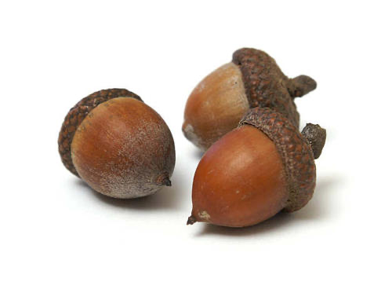
botany 场景词汇
birch [bə:tʃ] n.桦木；桦树；桦条
pliable [ˈplaɪəbəl] adj.柔韧的；柔软的；圆滑的；易曲折的
deciduous [dɪˈsɪdʒuəs] adj.落叶性的，脱落性的
bush [bʊʃ] n.灌木(丛), 矮树(丛)
vegetative ['vɛdʒə'tetɪv] adj.植物的; 蔬菜的
acorn [ˈekɔ:n] n.栎实
algae [ˈældʒi] n.水藻，海藻
fern [fɝn] n.蕨类植物
bloom [blu:m] n.花;开花期; v.开花
botany ['bɑtəni] n.植物，植物学
cluster [ˈklʌstɚ] n.丛；簇，串；群
phytoplankton [faɪtəʊ'plæŋktən] n.浮游植物
coral reef [ˈkɔrəl ri:f] 珊瑚礁
cordgrass ['kɔdɡræs] n.带状草地
moss [mɔs] n.苔藓
lichen ['laɪkən] n.地衣；青苔
cultivated [ˈkʌltɪvetɪd] adj.耕种的；栽培的；有教养的

Slide 16
botany场景词汇
edible [ˈedəbl] adj.可以吃的
inedible [ɪn'ɛdəbl] adj.不可食用的
germinate [ˈdʒə:məˌnet] vt./ vi.发芽；生长
hay [heɪ] n.干草
intervention [ˌɪntə'venʃn] n.介入，干涉
nectar [ˈnektə(r)] n.花蜜
nightcap oak ['naitkæp] [əuk] 夜冠橡树
oak [əʊk] n.橡树
organic [ɔ:ˈgænɪk] adj.有机的
plum [plʌm] n.李子，李树；李属植物；
tulip [ˈtu:lɪp] n.郁金香
pollination [ˌpɒlə'neʃn] n.授粉
scent [sent] n.香味，气味
odor ['oʊdə] n.气味
seedling ['sidlɪŋ] n.幼苗
soil [sɔɪl] n.泥土；土地
sugarcane ['ʃʊgɚ,ken] n.甘蔗

Slide 17
botany场景词汇
trunk [trʌŋk] n.树干
bundle ['bʌndl] n.捆, 束, 包
crop [krɑp] n.谷物
fiber ['faɪbə(r)] n.纤维
hemp [hɛmp] n.大麻(纤维)
shrub [ʃrʌb] n.灌木丛
textile [ 'tekstaɪl] n.织物; 纺织品
vegetation ['vɛdʒə'teʃən] n.植被
translocate [trænz'loket] v.移动；改变…的位置
transplantation [,trænsplɑːn'teʃən] n.移植
ash tree [æʃ] [triː] 白蜡树
aspen tree ['æspən][triː] 山杨树
bark [bɑ:k] n.树皮
spinach [‘spɪnɪtʃ] n.菠菜
disperse [dis'pə:s] vt.分散；使散开；传播

Slide 18
botany场景词汇
poisonous ['pɔɪzənəs] adj.毒的,引起中毒的, 有害的
detrimental [ˌdɛtrəˈmɛntl] adj.有害的
absorb [əbˈsɔ:b] v.吸收（液体、气体等）
delicate [ˈdelɪkət] adj.微妙的；熟练的；纤弱的
disposal [dɪˈspozəl] n.（事情的）处置
dense [dɛns] adj.稠密的；浓厚的
snap [snæp] vt.突然折断

Slide 19
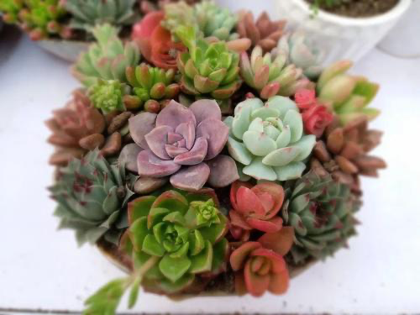
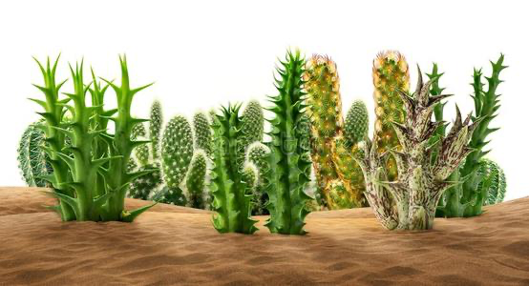
botany 精讲精练：
TPO41-lecture1 desert plant
harsh environment
adaptive
succulent plant 多汁的 肉质植物
植物的根、茎、叶三种营养器官中叶是肥厚多汁并且具备储藏大量水分功能的植物，也称“多浆植物
seep 渗
shallow root system
saturate 渗透
moist
evaporate
waxy outer layer
waterproof 防水的
stomate 气孔 （stomach）
dought-tolerate 耐旱
matabollism

Slide 20
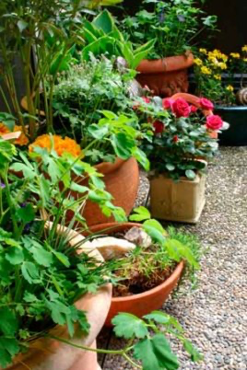
dormant state
light and brief 降雨小且少
revive 复活
annual plant 一年生植物 (在一年期间发芽、生长、开花然后死亡的植物:水稻、花生、高粱、南瓜、红薯、牵牛花、瓜叶菊、葫芦、翠菊、蛾蝶花、向日葵、大豆、辣椒、茄子、番茄、玉米、小麦、荸荠。)
wipe out 灭绝
unfavorable 不适宜的
far-between

Slide 21
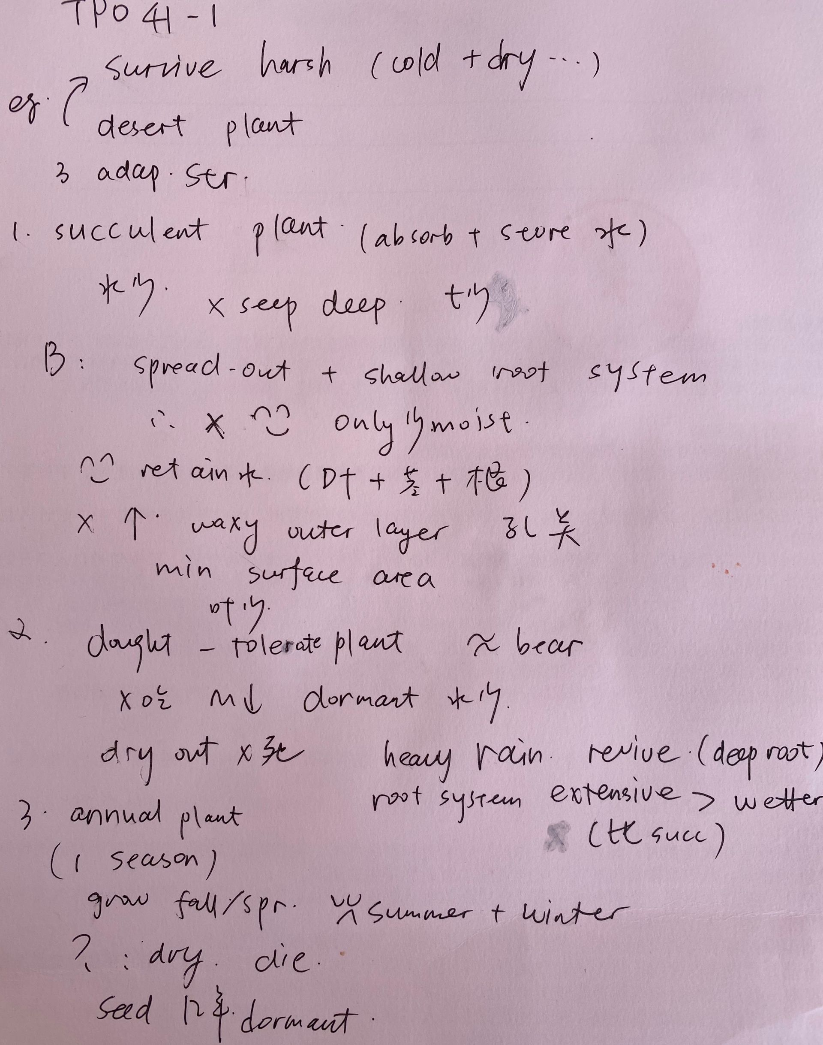
TPO41
lecture1
笔记

Slide 22
TPO41-lecture1
1.What is the lecture mainly about?
A. The growth rates of plants in different geographical regions
B. Different ways that plants have adapted to desert environments
C. The different mechanisms that plant roots use to absorb water
D. Different kinds of succulent plants

Slide 23
TPO41-lecture1
2.What are two features of succulent plants that help them survive in deserts? [Click on 2 answers.]
A. Succulent plants store water in their leaves and stems.
B. Succulent plants become dormant until the next rainfall.
C. Succulent plants have short stems.
D. Succulent plants have few leaves.

Slide 24
TPO41-lecture1
3.Why does the professor mention bears?
A. To remind students of information from a previous lecture
B. To point out a feature common to all desert plants
C. To reinforce a point about drought-tolerant plants
D. To help students understand the concept of adaptation

Slide 25
TPO41-lecture1
4.What is one ability that drought-tolerant plants have that succulent plants do not have?
A. The ability to absorb water from dry soil
B. The ability to absorb water through their leaves
C. The ability to prevent moisture from being lost through their leaves
D. The ability to shed leaves

Slide 26
TPO41-lecture1
5.Why can annual plants grow in a desert even after a year of no rainfall?
A. Annual plants have an extensive root system that can absorb water from far away.
B. Annual plants produce seeds all year long.
C. Seeds of annual plants can store water for a long time.
D. Seeds of annual plants can survive in the ground for a long time without water.

Slide 27
TPO41-lecture1
6.Listen again to part of the lecture. Then, answer the question.
A. To correct a previous statement
B. To acknowledge a potentially surprising fact
C. To anticipate the types of questions that students might have about the topic
D. To make sure that students are paying attention

Slide 28
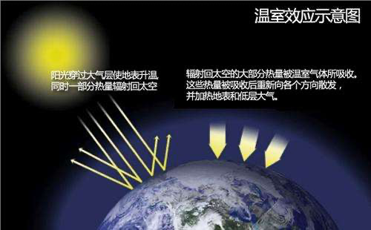
TPO40-lecture3温室效应
“花房效应”，是大气保温效应的俗称。大气能使太阳短波辐射到达地面，但地表受热后向外放出的大量长波热辐射线却被大气吸收，这样就使地表与低层大气温度增高，因其作用类似于栽培农作物的温室，故名温室效应
cellular level 细胞阶段
glucose 葡萄糖
outer space
photosynthesis
shellfish 贝壳
sequester 隐退 偏僻
imbalance
dig up
drill well 钻井
bathtub 浴缸
brim/spill over溢出
biomass fuel 生物燃料
buffalo dropping
peat 泥煤 bog 泥塘
carbon netutural 中性碳

Slide 29
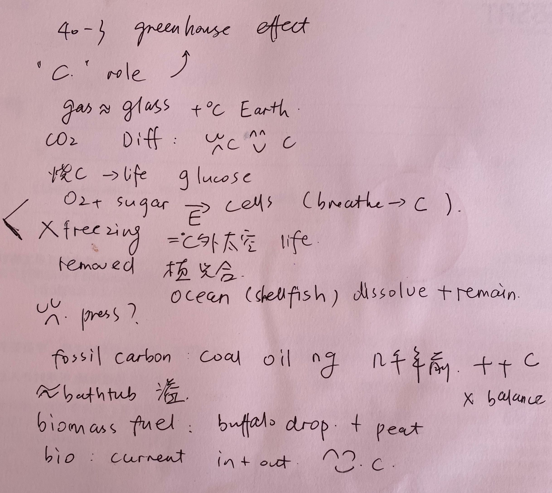
TPO40-lecture3
笔记

Slide 30
TPO40-lecture 3
1.What is the main purpose of the lecture?
A. To argue that carbon emissions today are not the only factor responsible for global warming
B. To provide evidence that rates of global carbon emissions fluctuate over time
C. To show the importance of distinguishing between different types of carbon emissions
D. To describe different ways carbon is removed from the atmosphere

Slide 31
TPO40-lecture 3
2.What aspects of outer space does the professor emphasize? [Click on 2 answers.]
A. Its vastness
B. Its cold temperatures
C. The absence of life there
D. Its role as the ultimate source of energy on Earth

Slide 32
TPO40-lecture 3
3.According to the professor, how do the oceans remove carbon from the atmosphere?
[Click on 2 answers.]
A. By dissolving it
B. Through a process of condensation and precipitation
C. By storing the remains of marine animals
D. Through the regulation of air temperature

Slide 33
TPO40-lecture 3
4.Why does the professor mention mining?
A. To explain why the price of fossil fuels is continually rising
B. To explain how certain fuel sources can be recovered from the ocean floor
C. To explain why coal and oil are more difficult to obtain than natural gas
D. To explain why fossil fuels contribute to an excess of carbon in the atmosphere

Slide 34
TPO40-lecture 3
5.What does the professor mean when he refers to biomass carbon as "current carbon"?
A. It is the fuel source most widely approved by environmentalists today.
B. It is part of a balanced system of carbon emission and absorption.
C. It is circulated throughout the oceans by the movement of ocean
D. It readily combines with other carbon molecules to produce long chains.

Slide 35
TPO40-lecture 3
6.Replay: Why does the professor say this
A. To let students know that the term “greenhouse effect” will be tested
B. To indicate that the definition of “greenhouse effect” will be discussed
C. To suggest that his previous definition of “greenhouse effect” was imprecise
D. To acknowledge that there is controversy surrounding the use of the term “greenhouse effect”water.

Slide 36
课后作业：
1. 回顾本次课内容，botany 单词记忆内容
2. 完成TPO51-1；43-1；38-1的所有lecture题目
3. 预习第9次课中business+history科学词汇
题目群里打卡

Slide 37

【✨课程福利✨】
1. 微博打卡：#考虫托福系统班#+天数+收获+图片+@考虫托福 @相应科目的老师 @酵母菁
（1）每周一抽取2个上周连续打卡的虫子送抱枕
2. 听课评论，听课后点击右上角【评论】按钮，说说虫子们对课程的想法和感受，课程结束后抽2个考虫T恤喔！

Slide 38
综合练习：
TPO51-C2
reception 招待会
modest 谦虚
approve the funding 批准经费
freight 货运

Slide 39
综合练习：
TPO51-C2
1.Why does the student go to see the woman?
A. To ask her for help with organizing an event
B. To invite her to a reception at an art gallery
C. To request additional funds for a student activity
D. To suggest a last-minute change in plans for a trip

Slide 40
综合练习：
TPO51-C2
2.What point does the student make about his job in the Student Activities Center?
A. He found out about the art exhibit from someone he works with.
B. His roommate helped him to get the job.
C. The job typically involves organizing trips to New York City.
D. The activities that the center organizes are popular.

Slide 41
综合练习：
TPO51-C2
3.What two points does the student make about the history of the High Line?
[Click on 2 answers.]
A. The High Line once was part of a train line that transported freight
B. The High Line originally was built as a park for outdoor art exhibits.
C. The High Line has long been a popular destination for tourists to New York City.
D. The High Line was not used for many years.

Slide 42
综合练习：
TPO51-C2
4.Why does the woman mention the information in the poster?
A. To point out that the tour leader's name was not listed
B. To point out a problem with the student's suggestion about walking to the gallery
C. To explain why so few students signed up for the trip
D. To explain why the bus would not be available for taking the students on the trip

Slide 43
综合练习：
TPO51-C2
5.What does the woman imply when she says this:
A. She has already seen the art exhibit.
B. She would be willing to go on the trip.
C. She prefers walking to taking the bus in New York.
D. She is surprised that she has not heard of the High Line.

Slide 44
End

